Slide 1
Operations Report
November 16, 2021
1
Notes:
Update Date and Footer

Slide 2
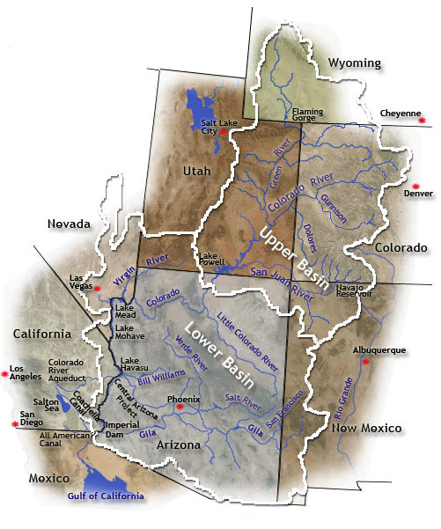
Colorado River Basin – Lower Basin water availability is dependent on Upper Basin snow and precipitation
2
2
Notes:
Map file located in \\APASRV05\Data\Graphics\Maps\ColoradoRiverBasin.gif
It never changes so don’t worry about it.
New map: http://www.crwua.org/coloradoriver/index.cfm?action=rivermap

Slide 3
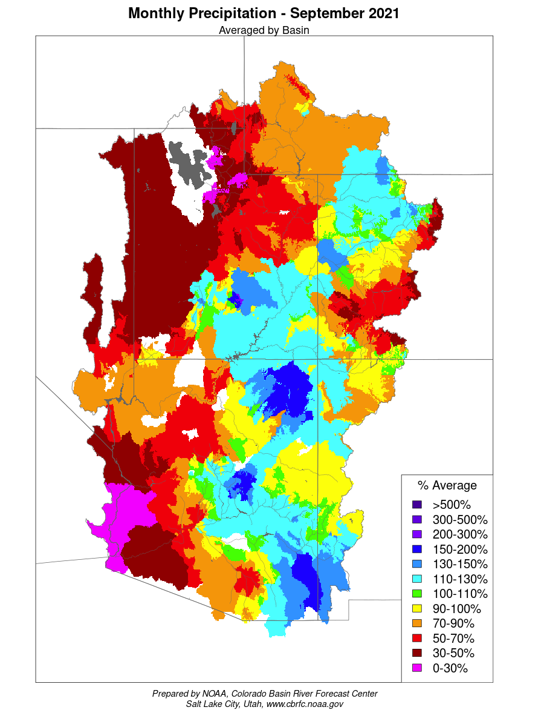
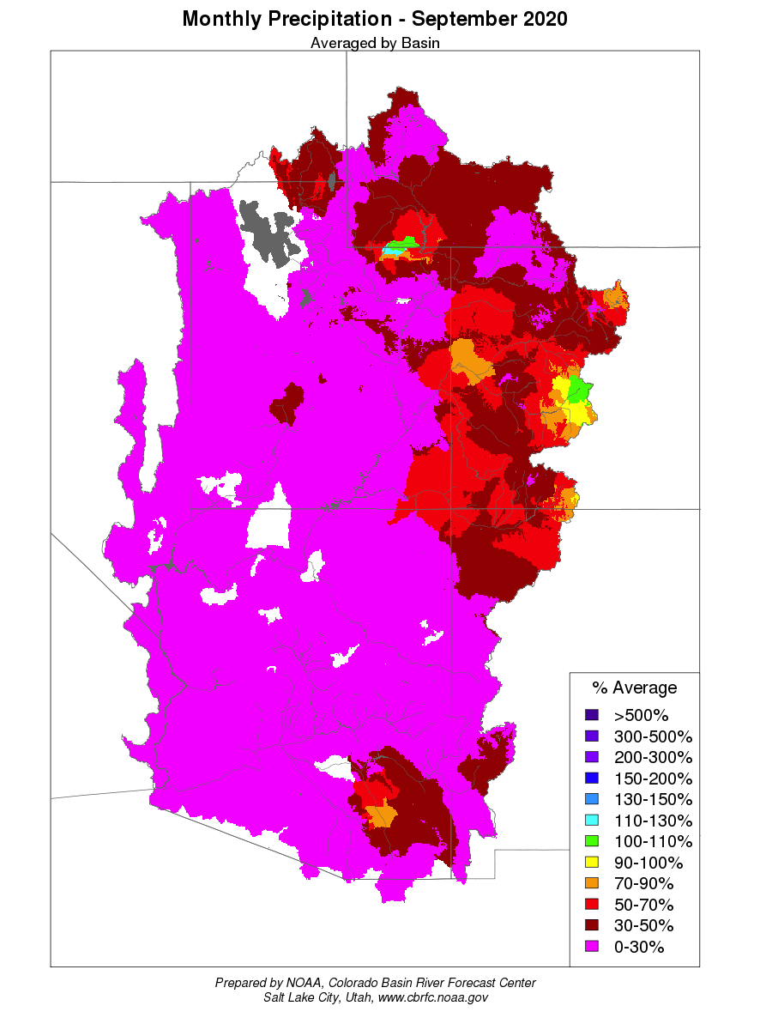
Monthly Precipitation
3
3
Notes:
http://www.cbrfc.noaa.gov
Precipitation – under water supply at the bottom of the homepage

Slide 4
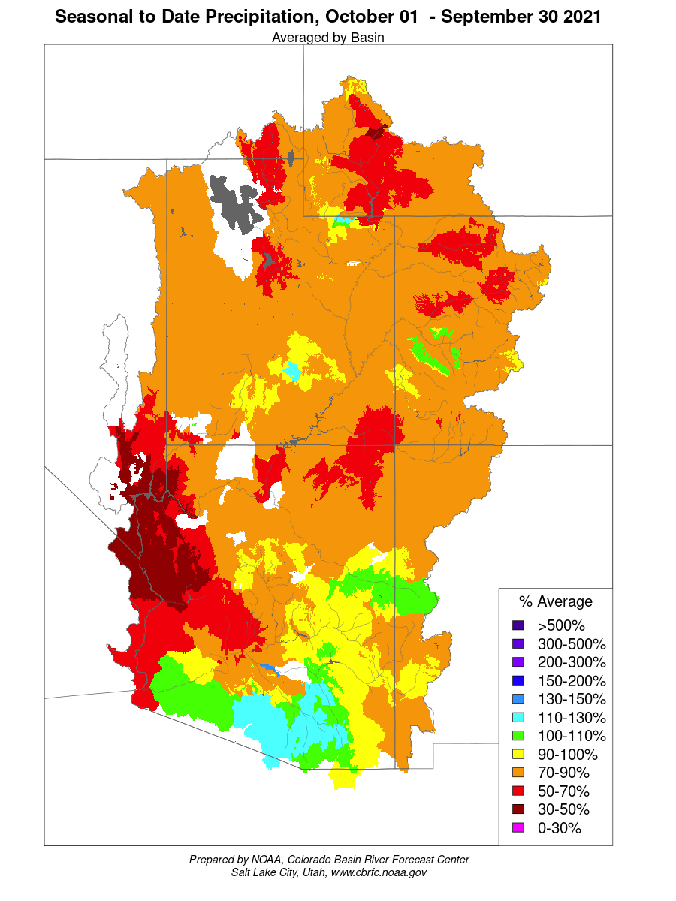
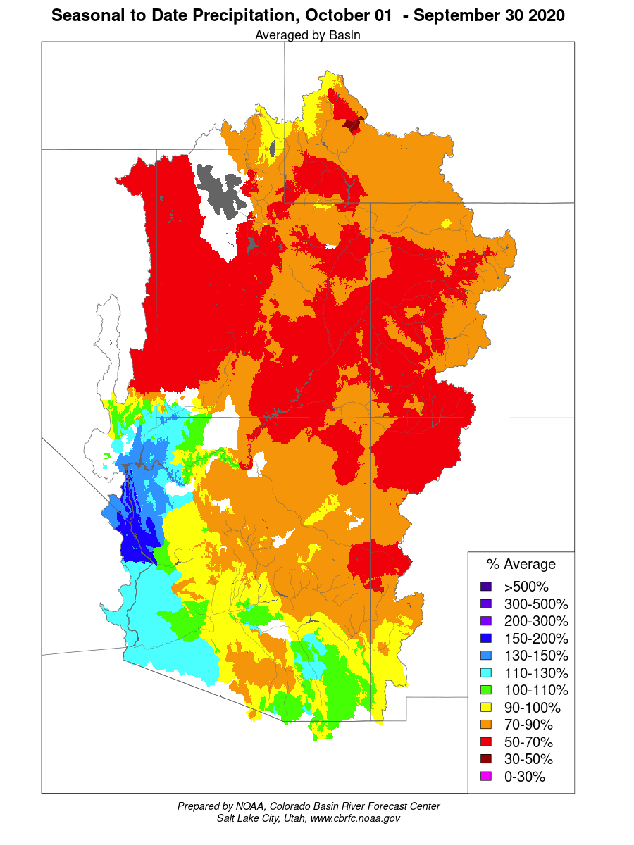
Seasonal Precipitation
4
4
Notes:
http://www.cbrfc.noaa.gov
Precipitation – Observed – CBRFC-Monthly
Seasonal
Size: H-5.59”, W-4.82”, Scale-67%

Slide 5
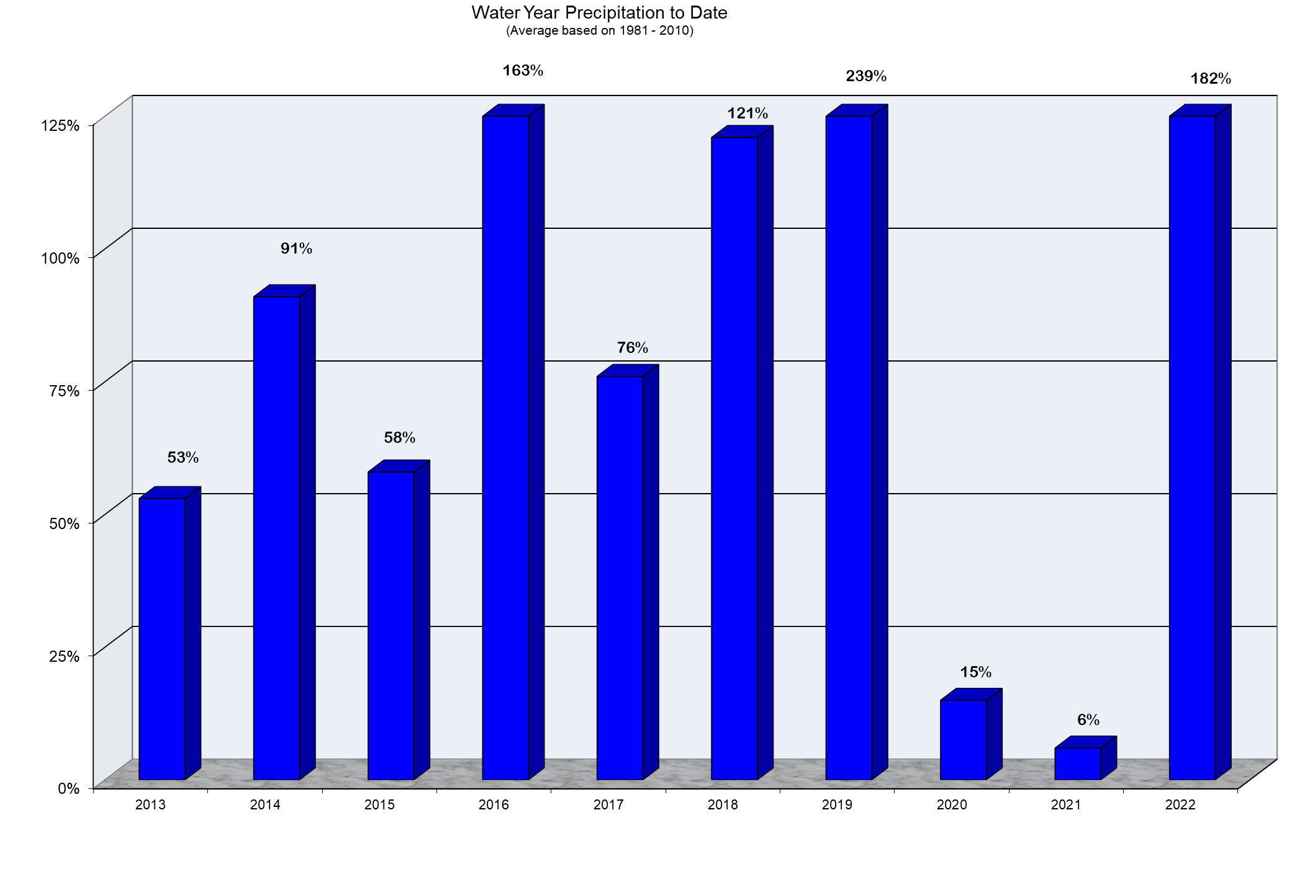
Upper Colorado River System
5
5
Notes:
Get the info from the “Lower Colorado Water Supply Report” sent out once a week (bottom of page). Update the current precipitation and enter that in the current month /year cell on the precipitation and snowpack spreadsheet. On the precip and snow spreadsheet select the data for the current month.

Slide 6
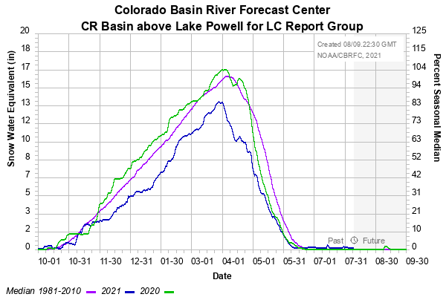
Notes:
Select snow groups from the snow drop down menu on the CBRFC.noaa.gov homepage. On the snotel page scroll down half way and select CR Basin above Lake Powell for LC report group. The report takes a up to a minute to appear.
Not updated for 10/26 – website down.

Slide 7
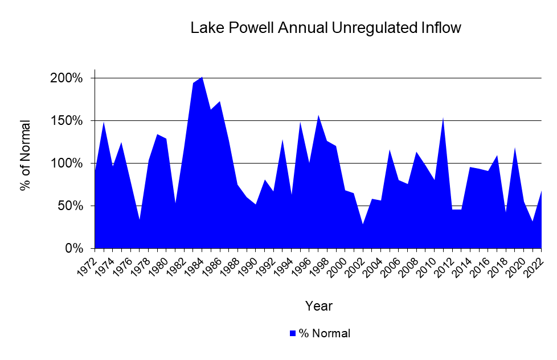
68%
Normal = 10.8575 MAF
1981 to 2010
7
Notes:
24-Month Report – use Lower Colorado Water Supply Report for current month. on the Lake Powell annual spreadsheet. The average will be calculated using the average in column D. The percentage is manually entered on the PowerPoint page. (In the first weeks of the operating year, the weekly water report continues to use the Powell inflow from the previous year. During that time, use the Powell unregulated inflow in the 24-month report.)

Slide 8
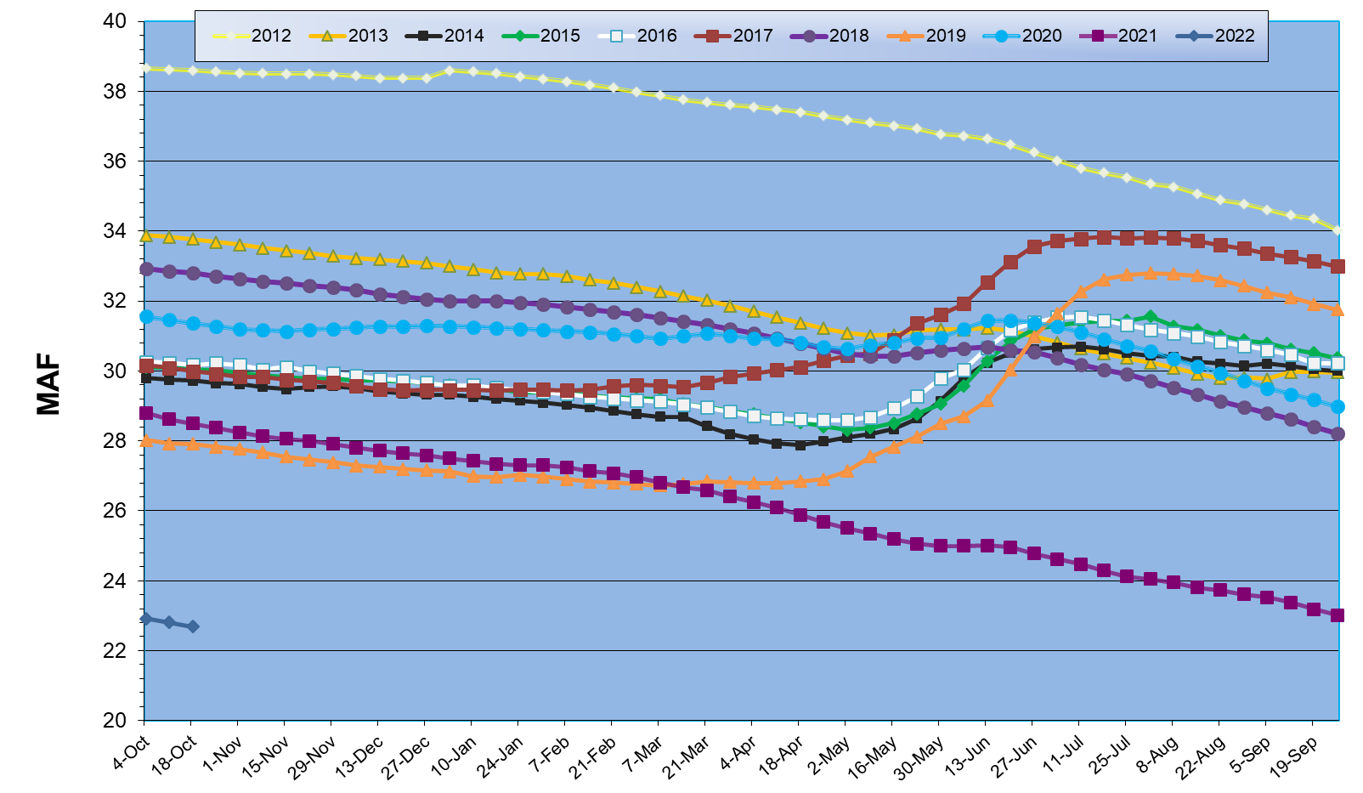
Total System Contents
Notes:
The basin total spreadsheet has the total system contents for each month. Enter the amount for the previous 4 weeks and update the data on the basin chart.

Slide 9
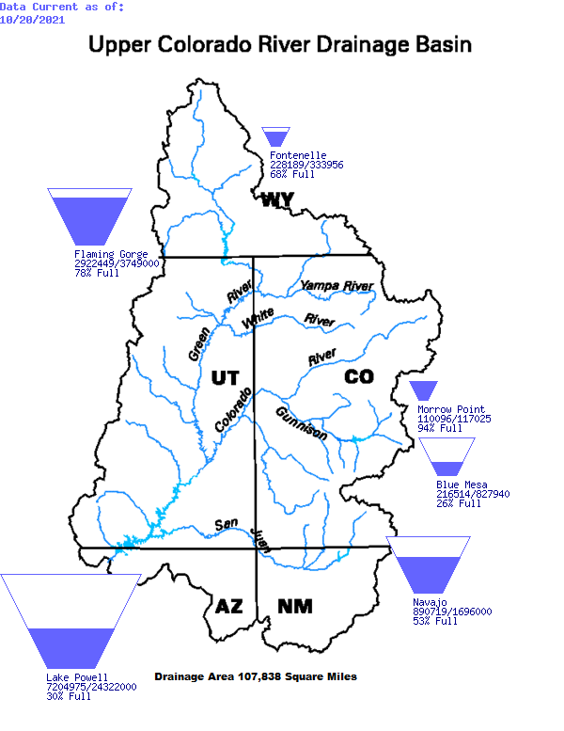
Upper Colorado River Drainage Basin
v
Tea-Cup Diagram
as of 10/20/21
9
9
Notes:
Map from http://www.usbr.gov/uc/water/basin/tc_cr.html

Slide 10
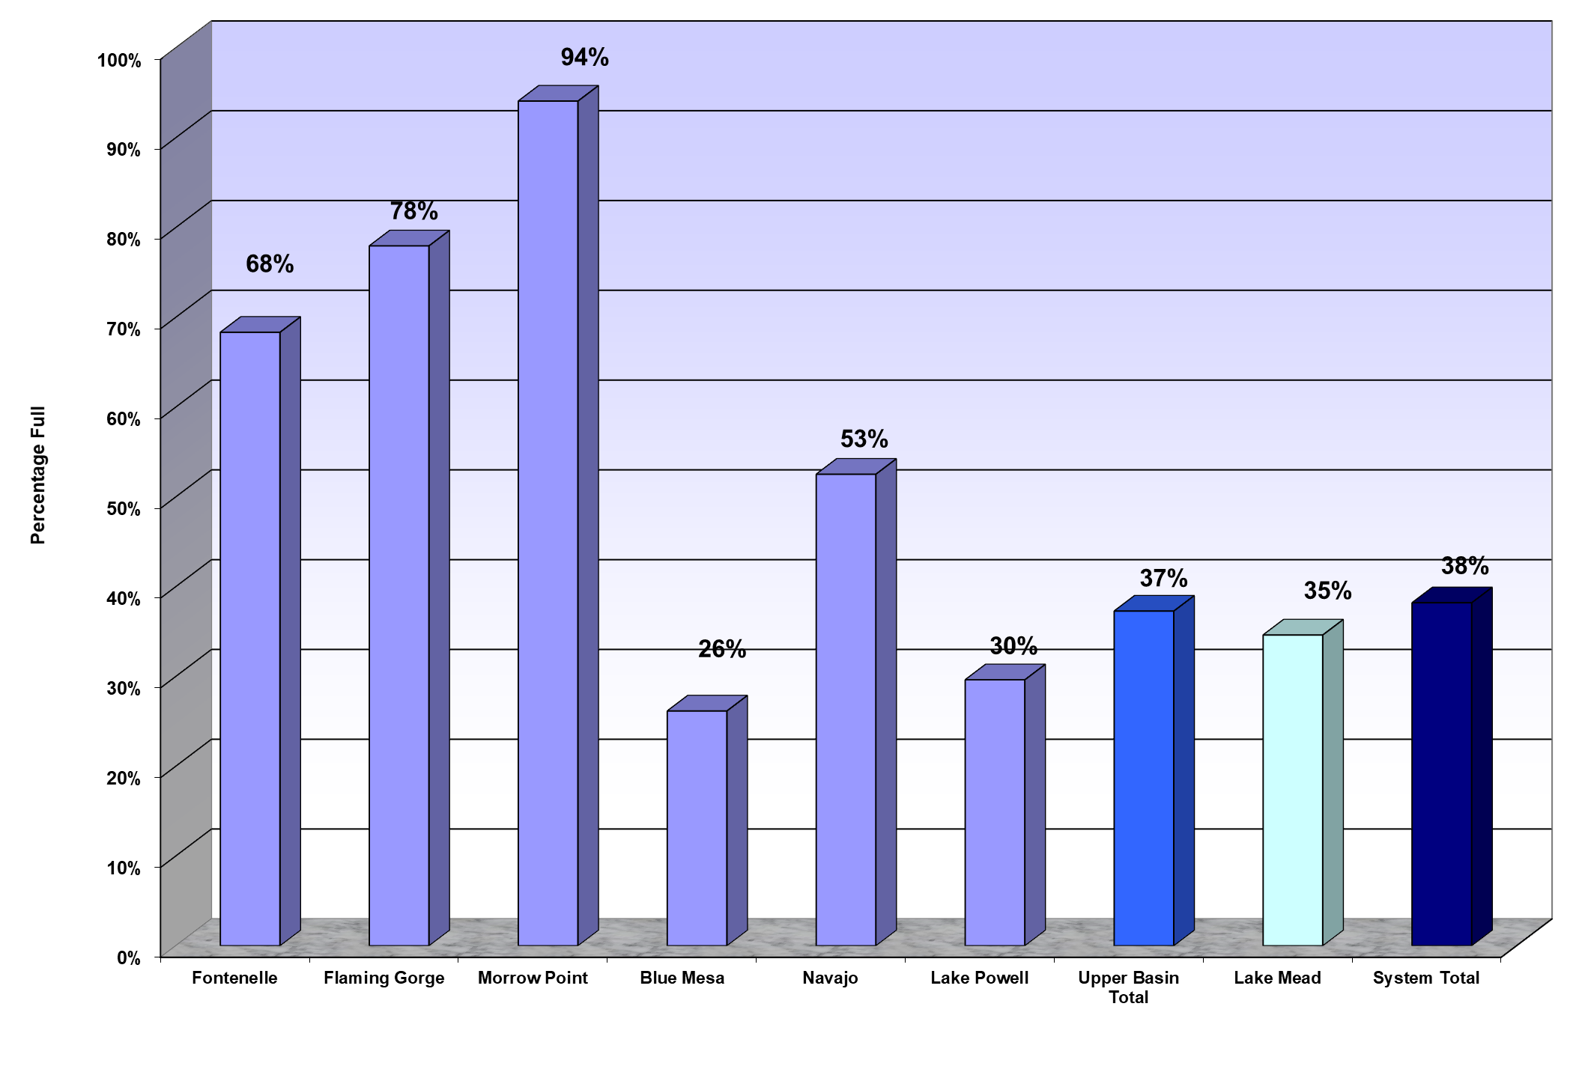
Reservoir and System Capacity as of 10/20/21
10
10
Notes:
The basin percentages are calculated on the reservoir capacity - taken from the Tea Cup map— the Lake Mead and Lake Powel are linked to the amounts on the watersupply spreadsheet.
Update the date on the top to the date on the teacup diagram.

Slide 11
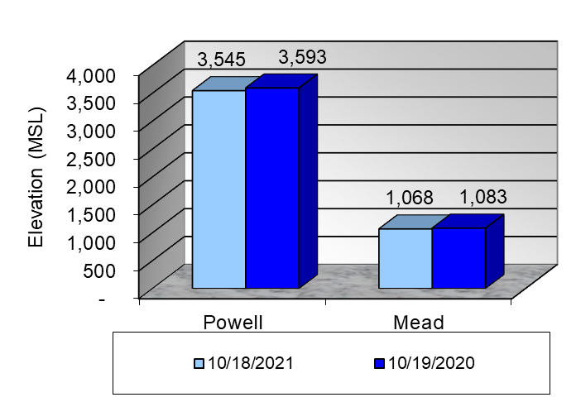
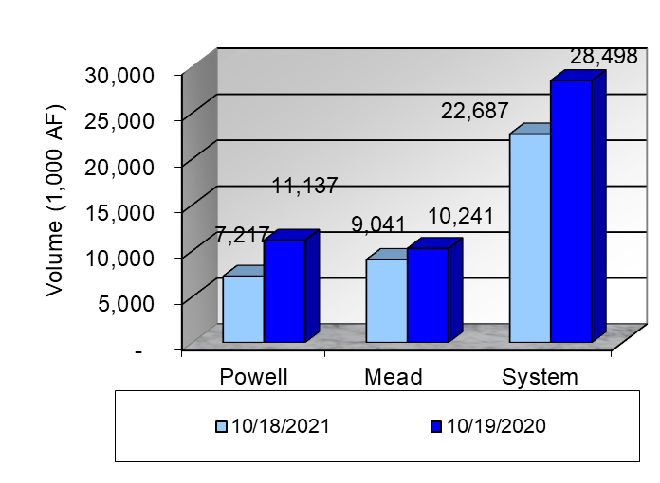
Colorado River Water Supply As of August 9, 2021 & August 10, 2020
11
11
Notes:
Lower Colorado Water Supply Report.- Use the most recent weekly water supply and the one from the year below to enter the amounts for elevation and content. Make sure to correct the dates at the top of the powerpoint.

Slide 12
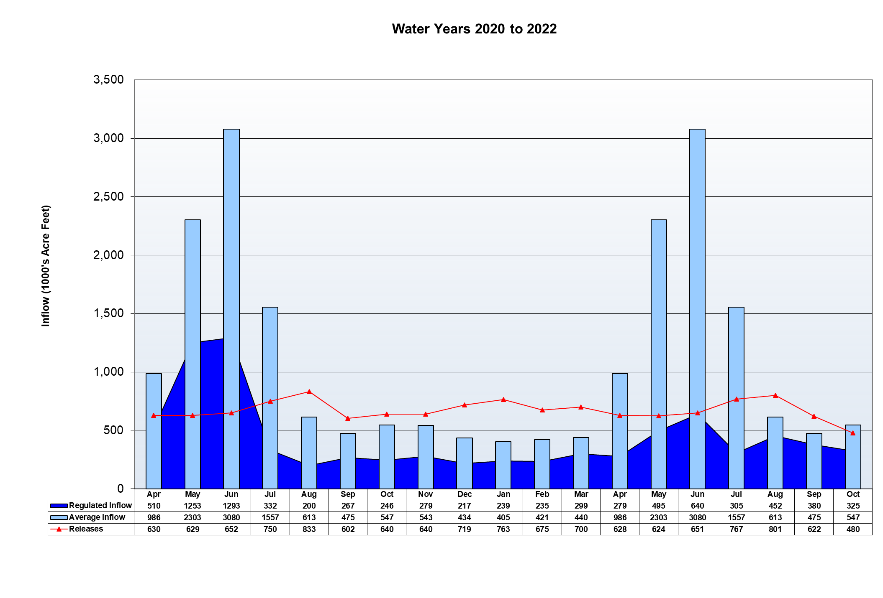
Lake Powell Actual vs. Average Inflow
WY 2020
WY 2021
WY 2022
12
Notes:
Using the Lake Powell page of the 24-month study enter the regulated inflow and releases on the lakepowellinlow spreadsheet making a new column for the current month. The average inflow repeats every year. Check the previous 2 months because they may have changed due to the bureau updating the amounts. Select data for the chart moving one month forward . After copying and pasting to this page slide the background shapes to reflect a water year by starting with October and ending with September.

Slide 13
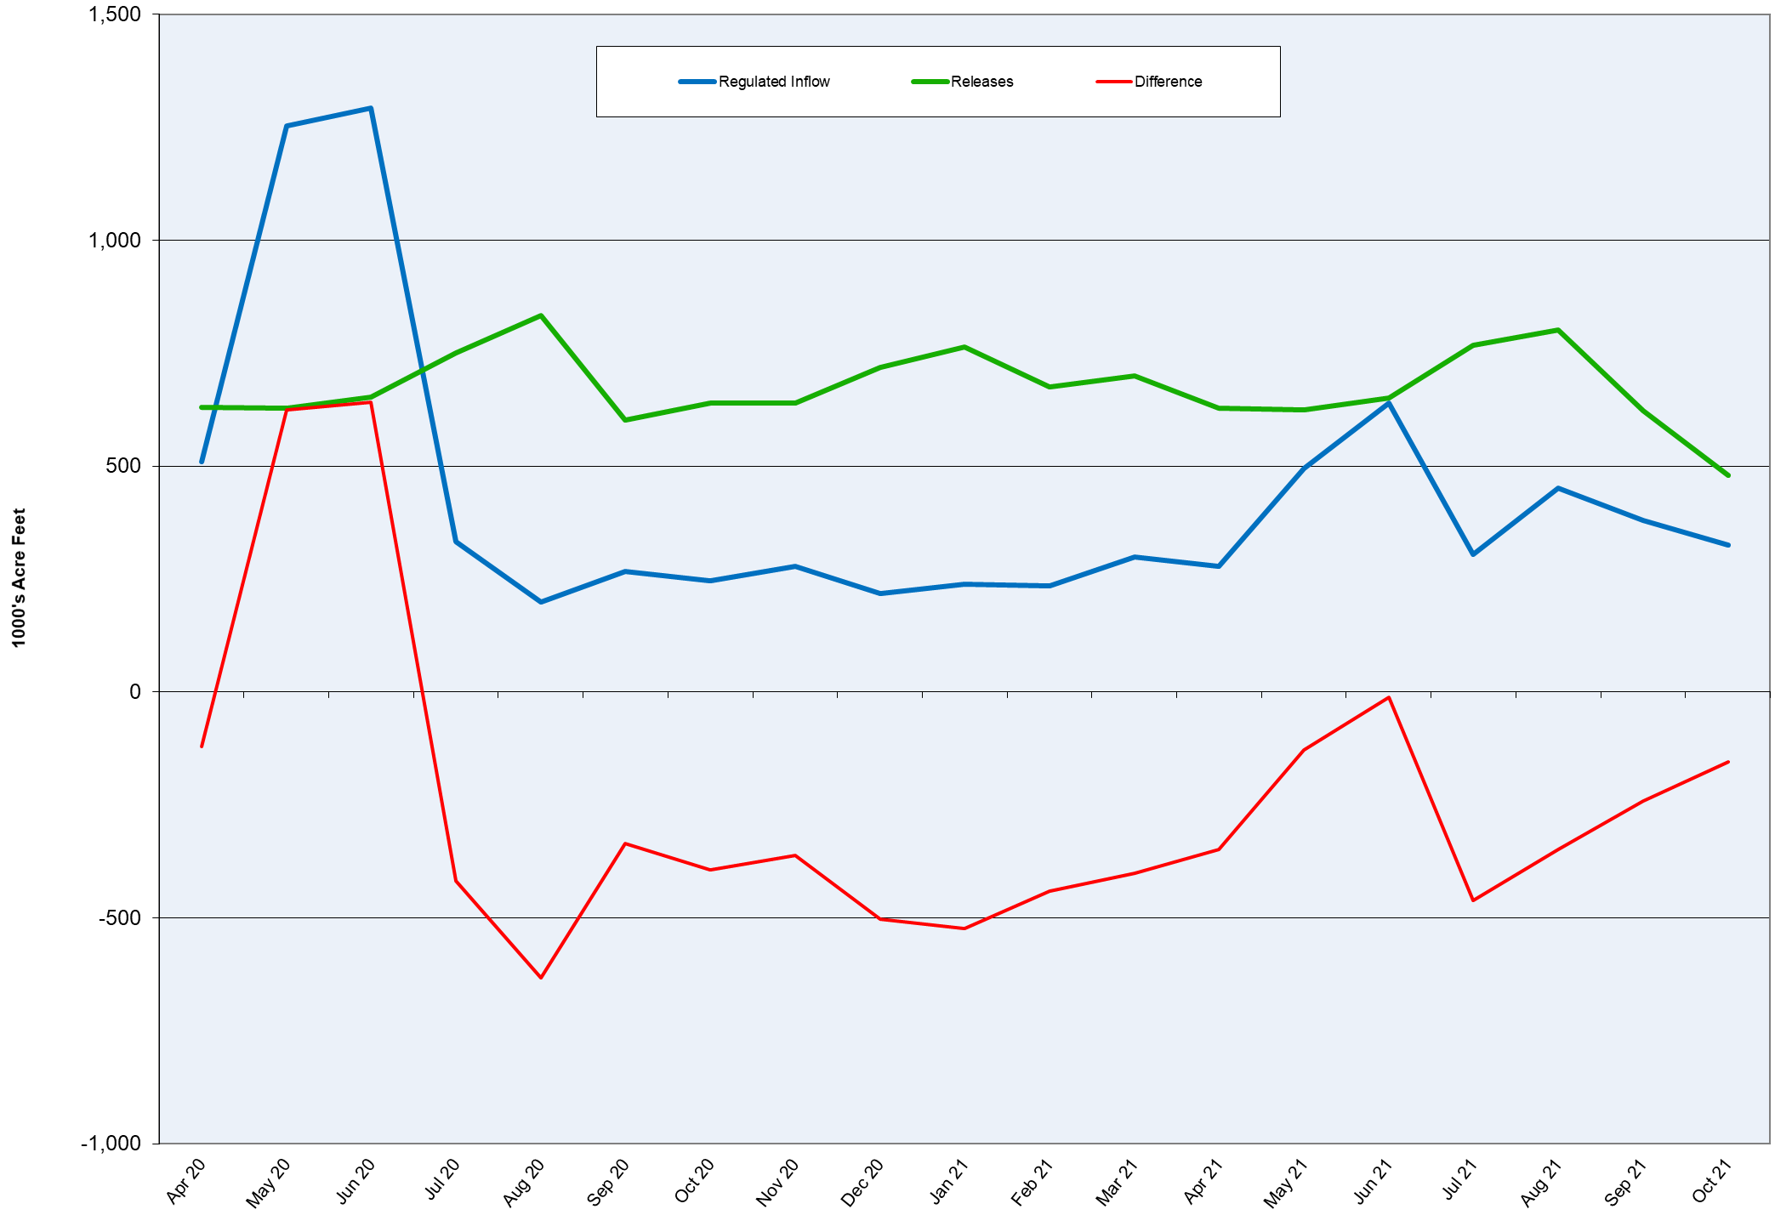
Lake Powell Inflow vs. Releases
Water Years 2020 to 2022
13
Notes:
This graph uses the same data as the lake Powell inflow chart.

Slide 14
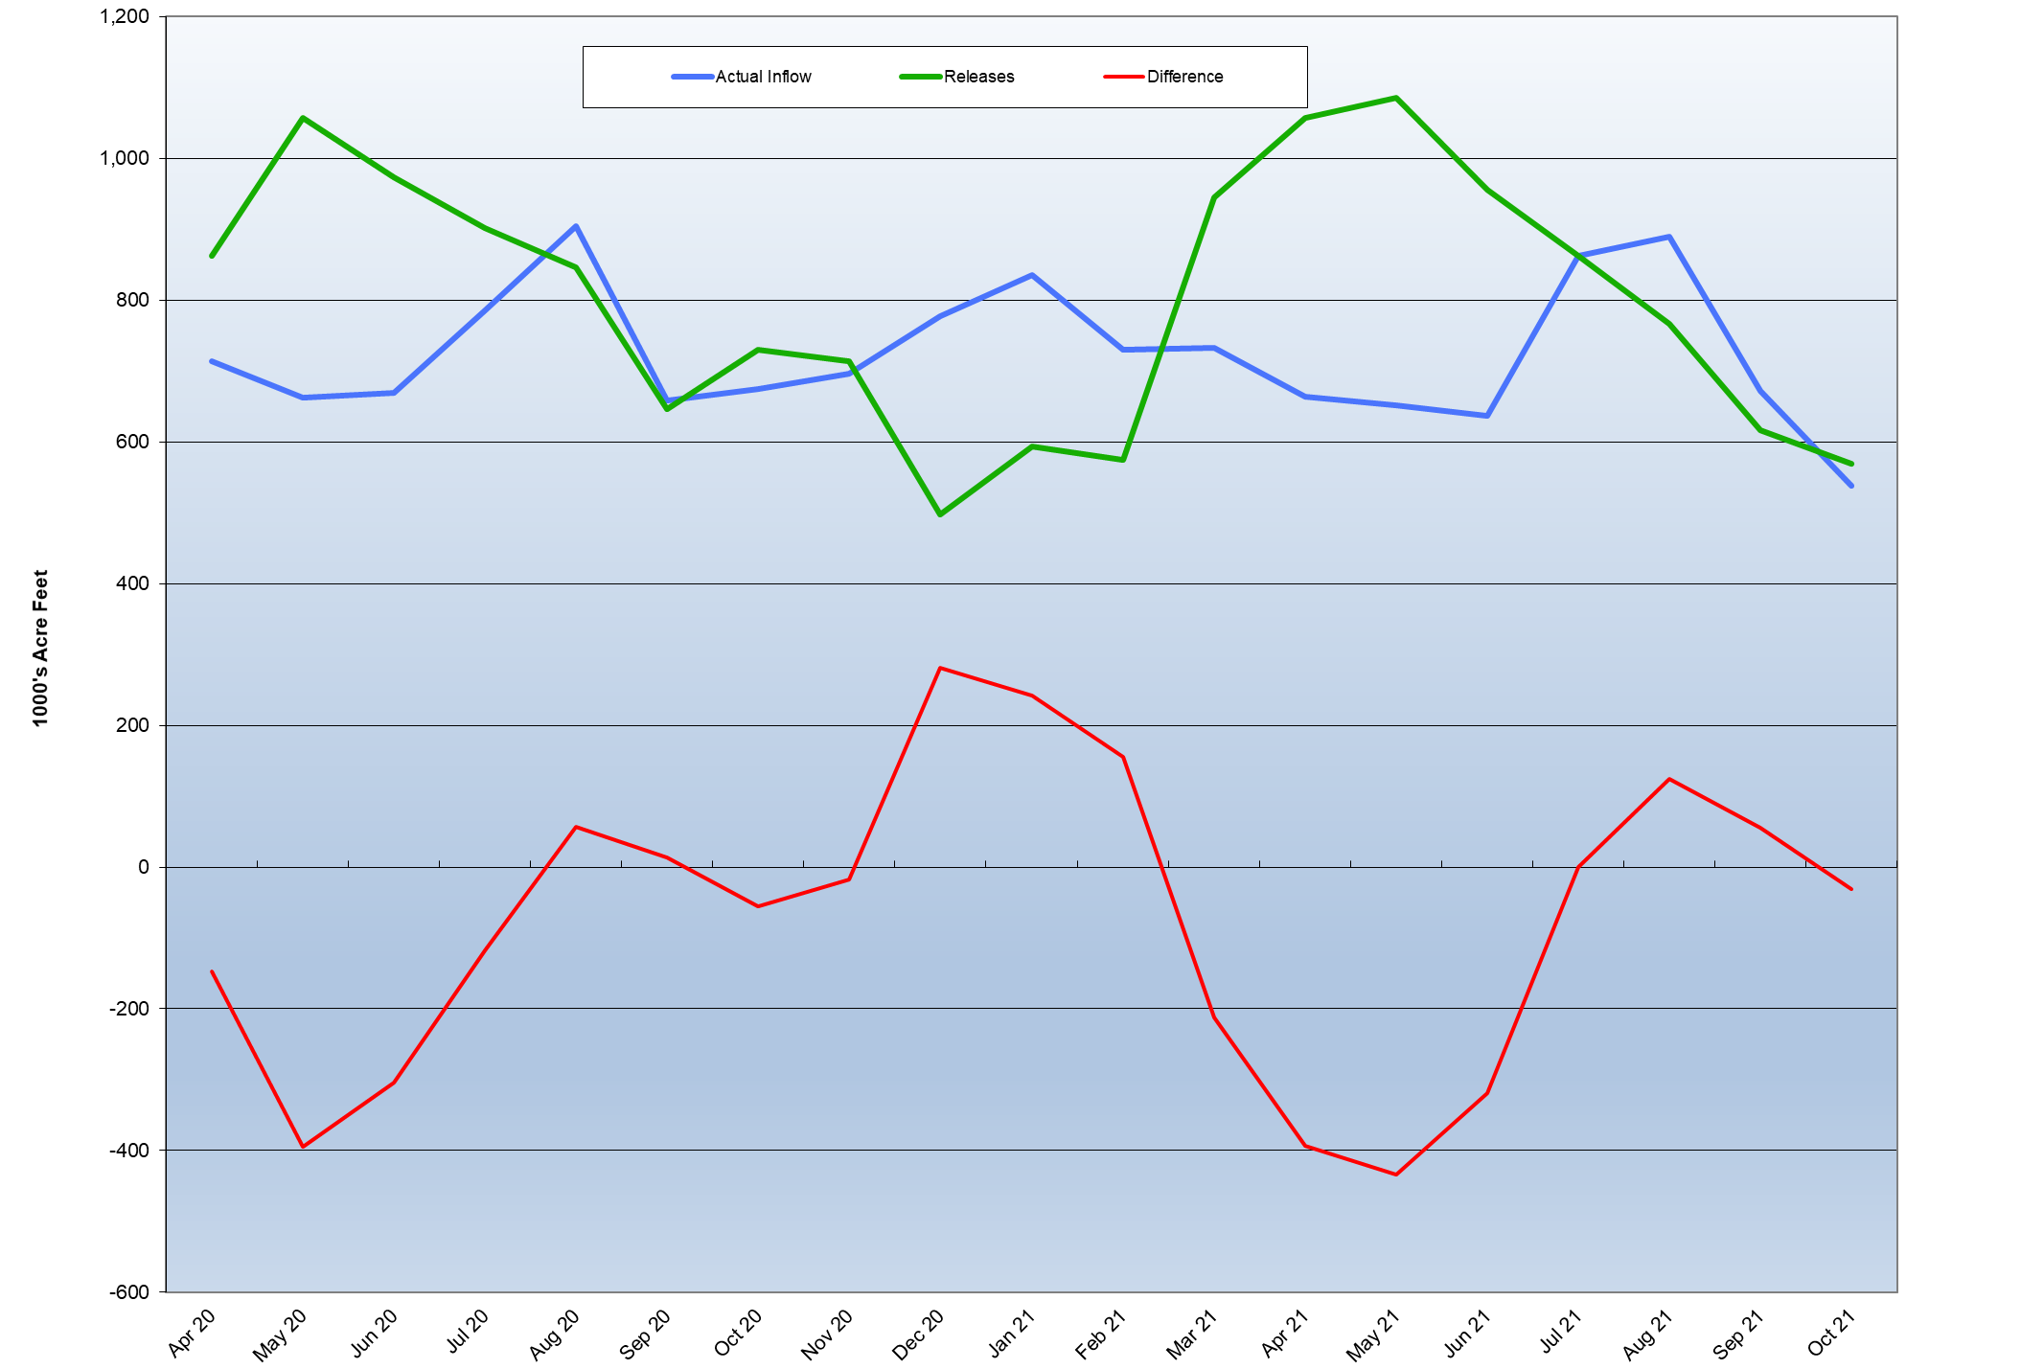
Mead Inflow vs. Release
Water Years 2020 to 2022
Notes:
Data entered from the 24-month study and entered on the new mead graphs spreadsheet. The Mead inflow v. Release spreadsheet data moves up one month.

Slide 15
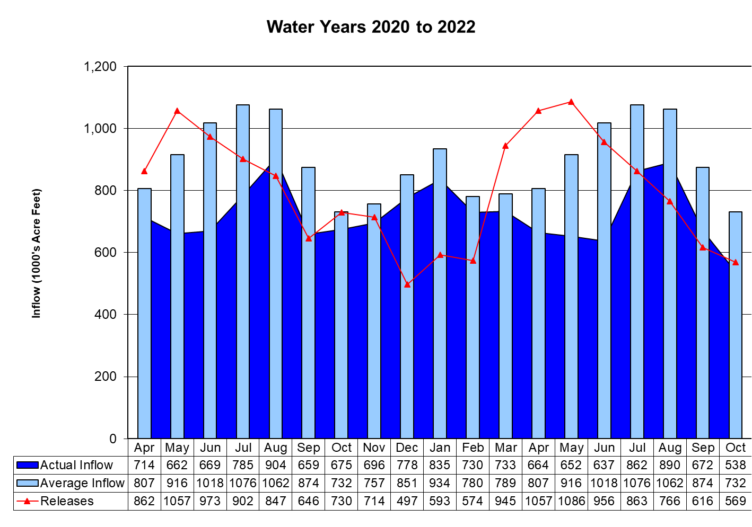
Lake Mead Actual vs. Average Inflow
OY 2020
OY 2021
OY 2022
Notes:
This chart data comes from the LakeMeadInflow Chart and is updated on the Mead inflow Gen. Spreadsheet. The actual inflow is the powell release plus the side inflow. Check the previous months for changes.
Make sure the names on the data table are correct. Move the shapes behind the water years are on October through September.

Slide 16
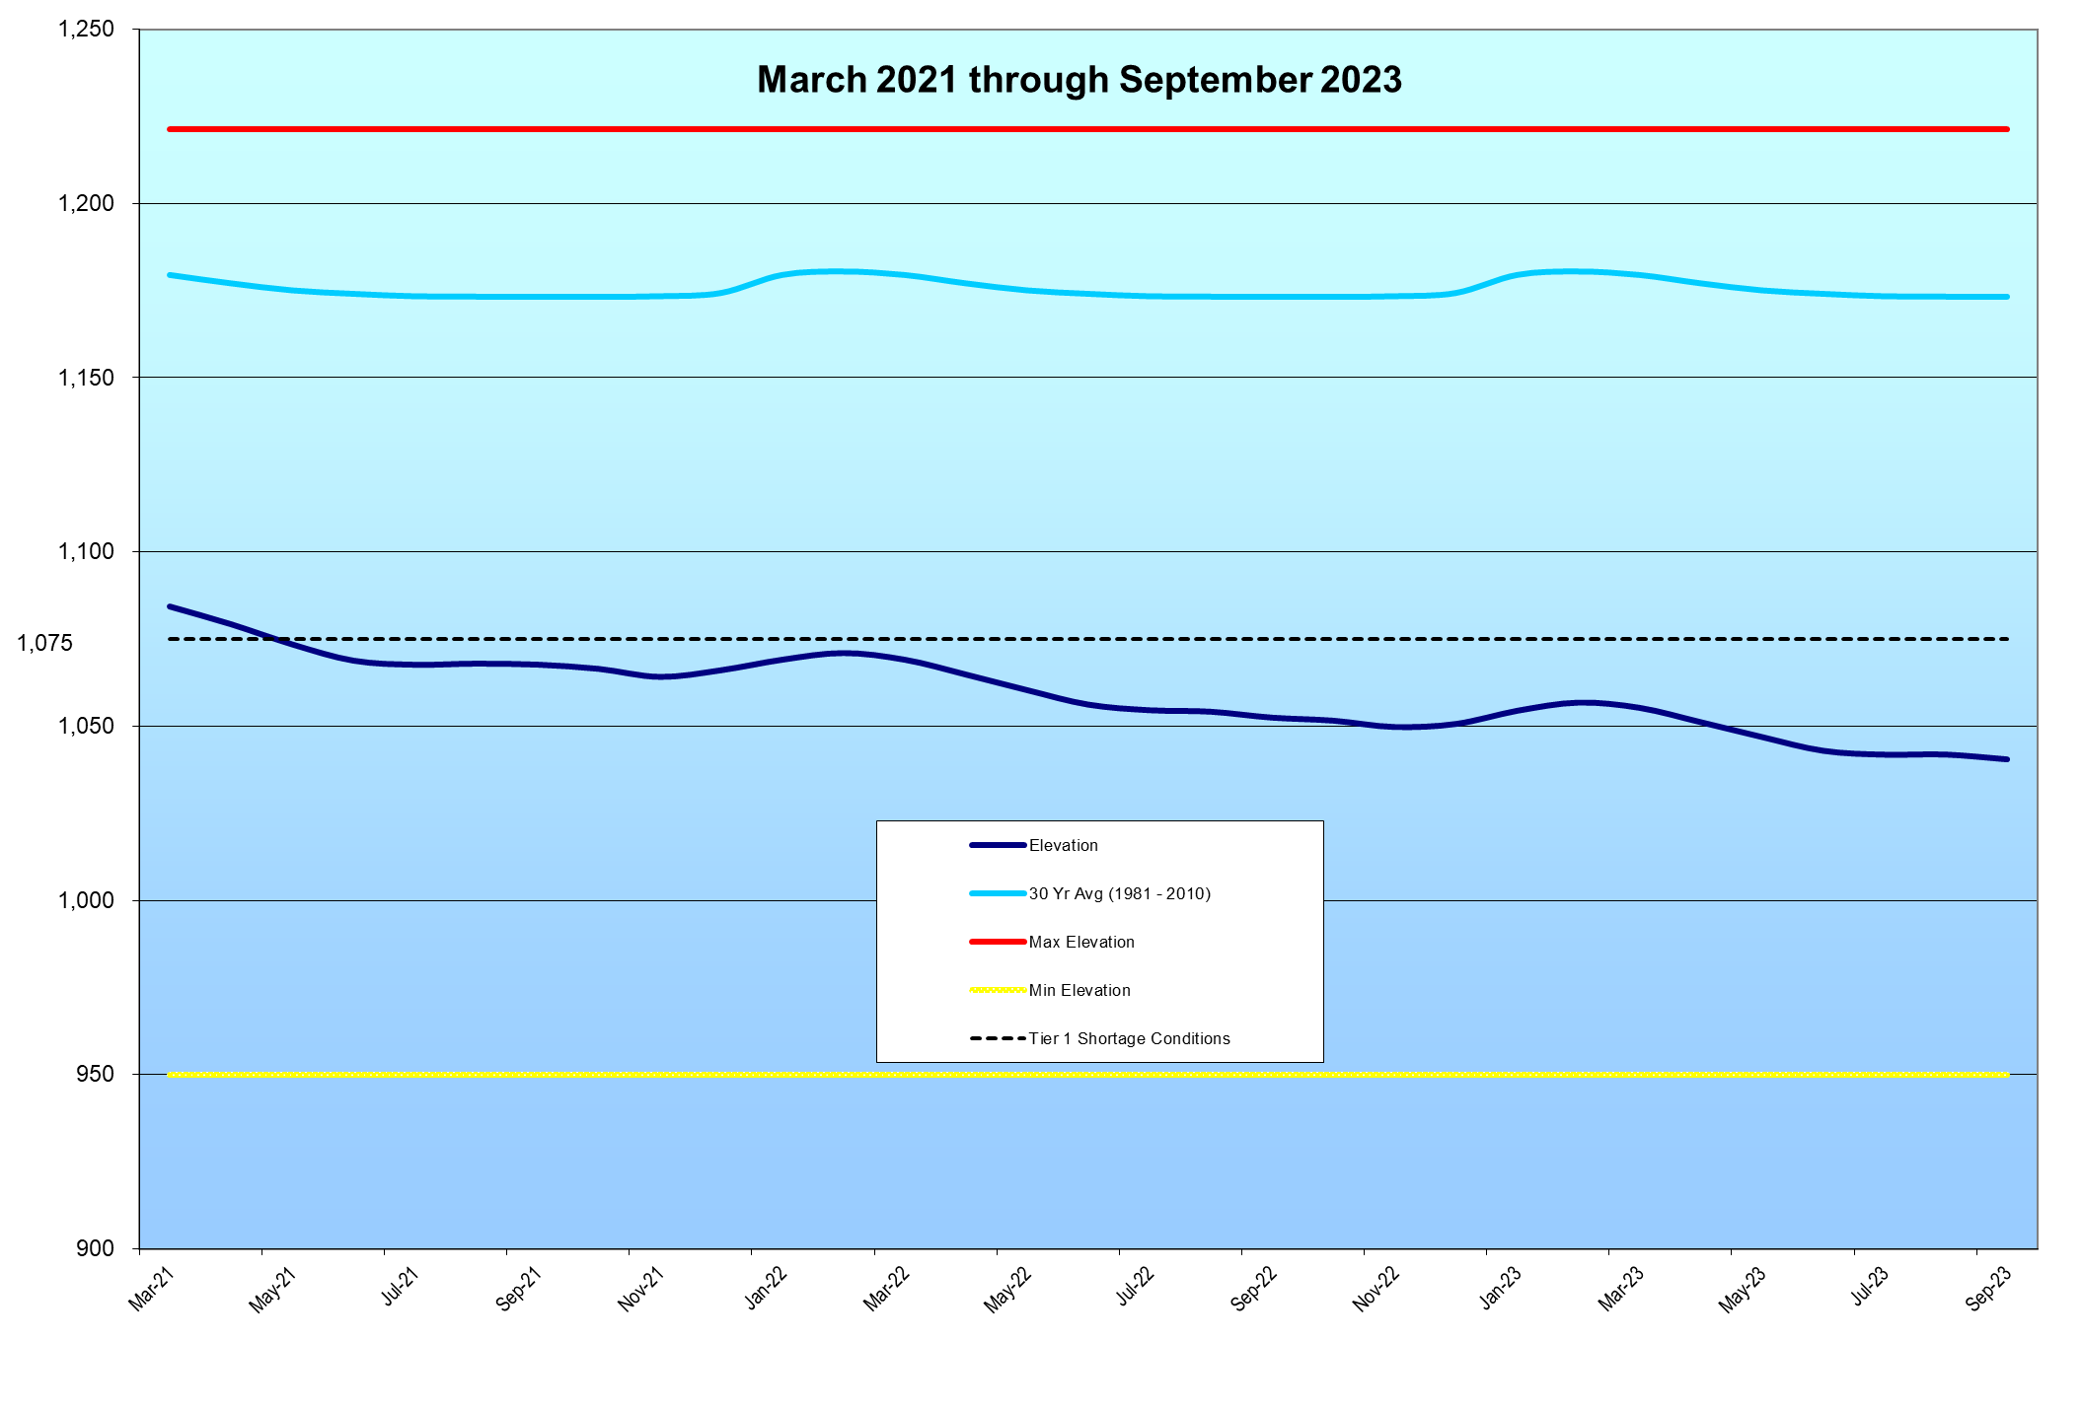
Lake Mead Elevation
Forecast
1040.42
16
16
Notes:
Change numbers from the 24 month study, under “Reservoir Elevation EOM Feet” on Hoover Dam-Lake Mead (2nd page). Move line to current timeframe.
Change dates at the top to the months covered in the graph.

Slide 17
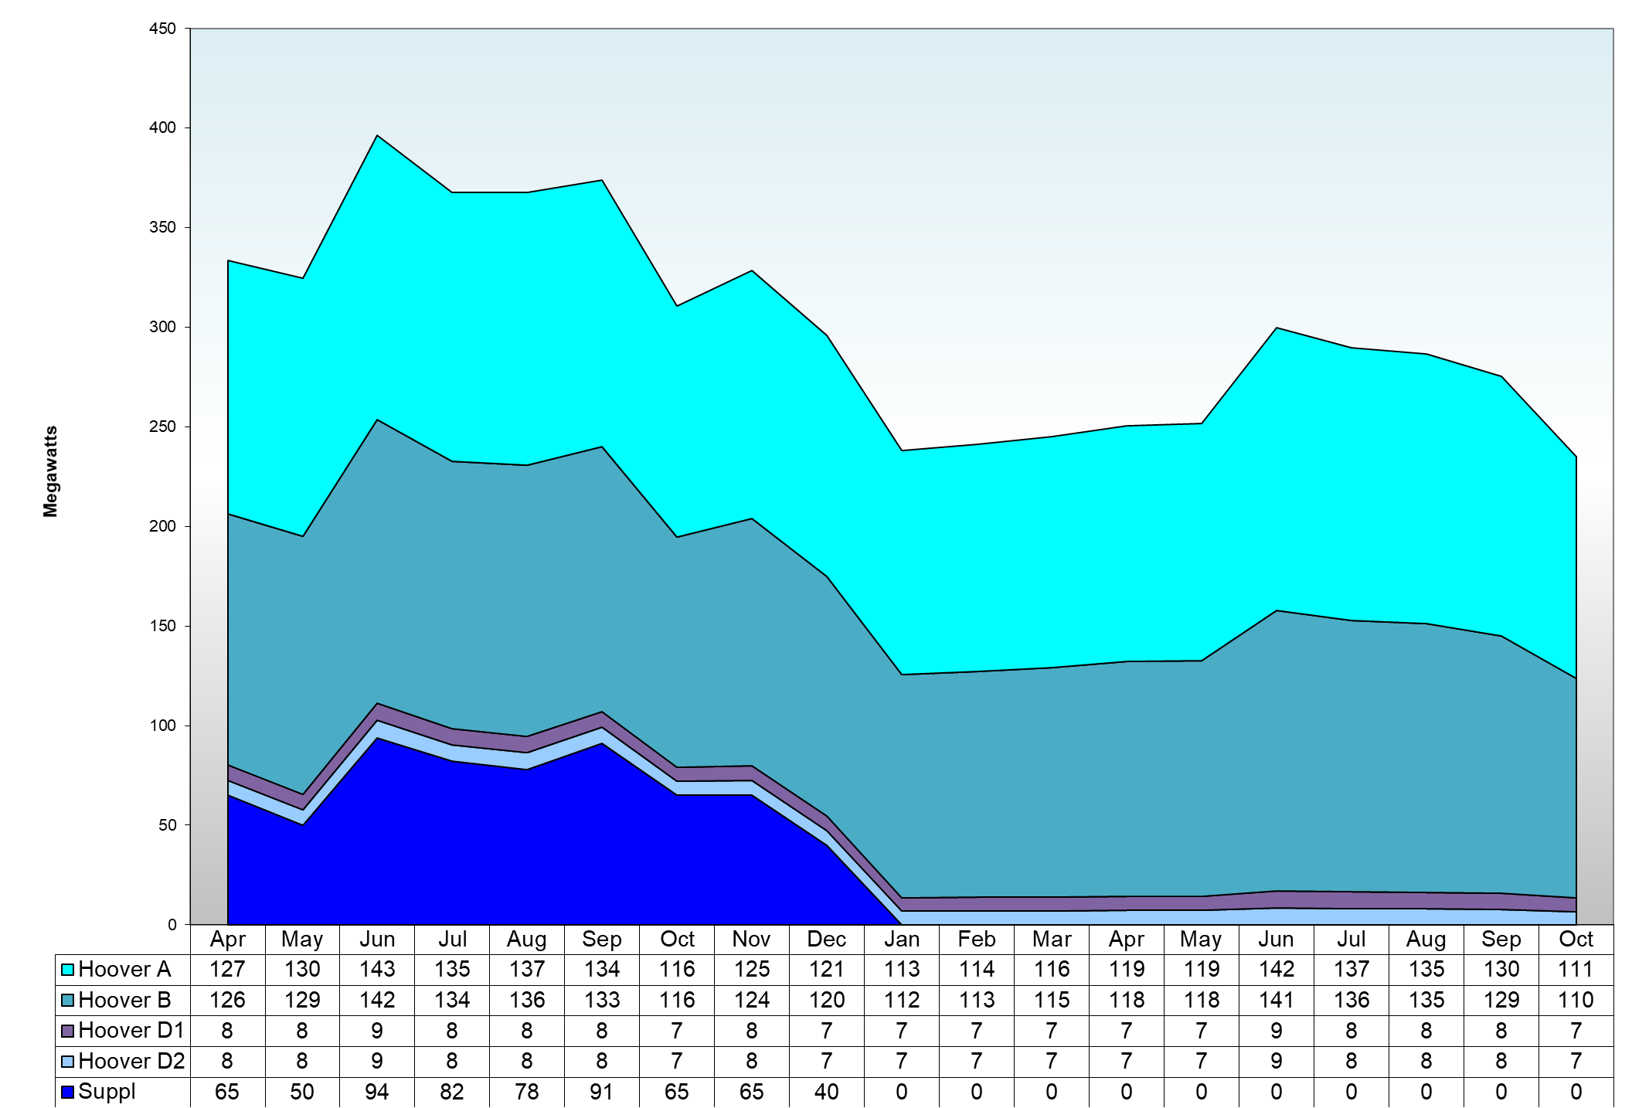
APA Monthly Capacity Scheduled April 2020 – October 2021
OY 2020
OY 2021
OY 2022

Slide 18
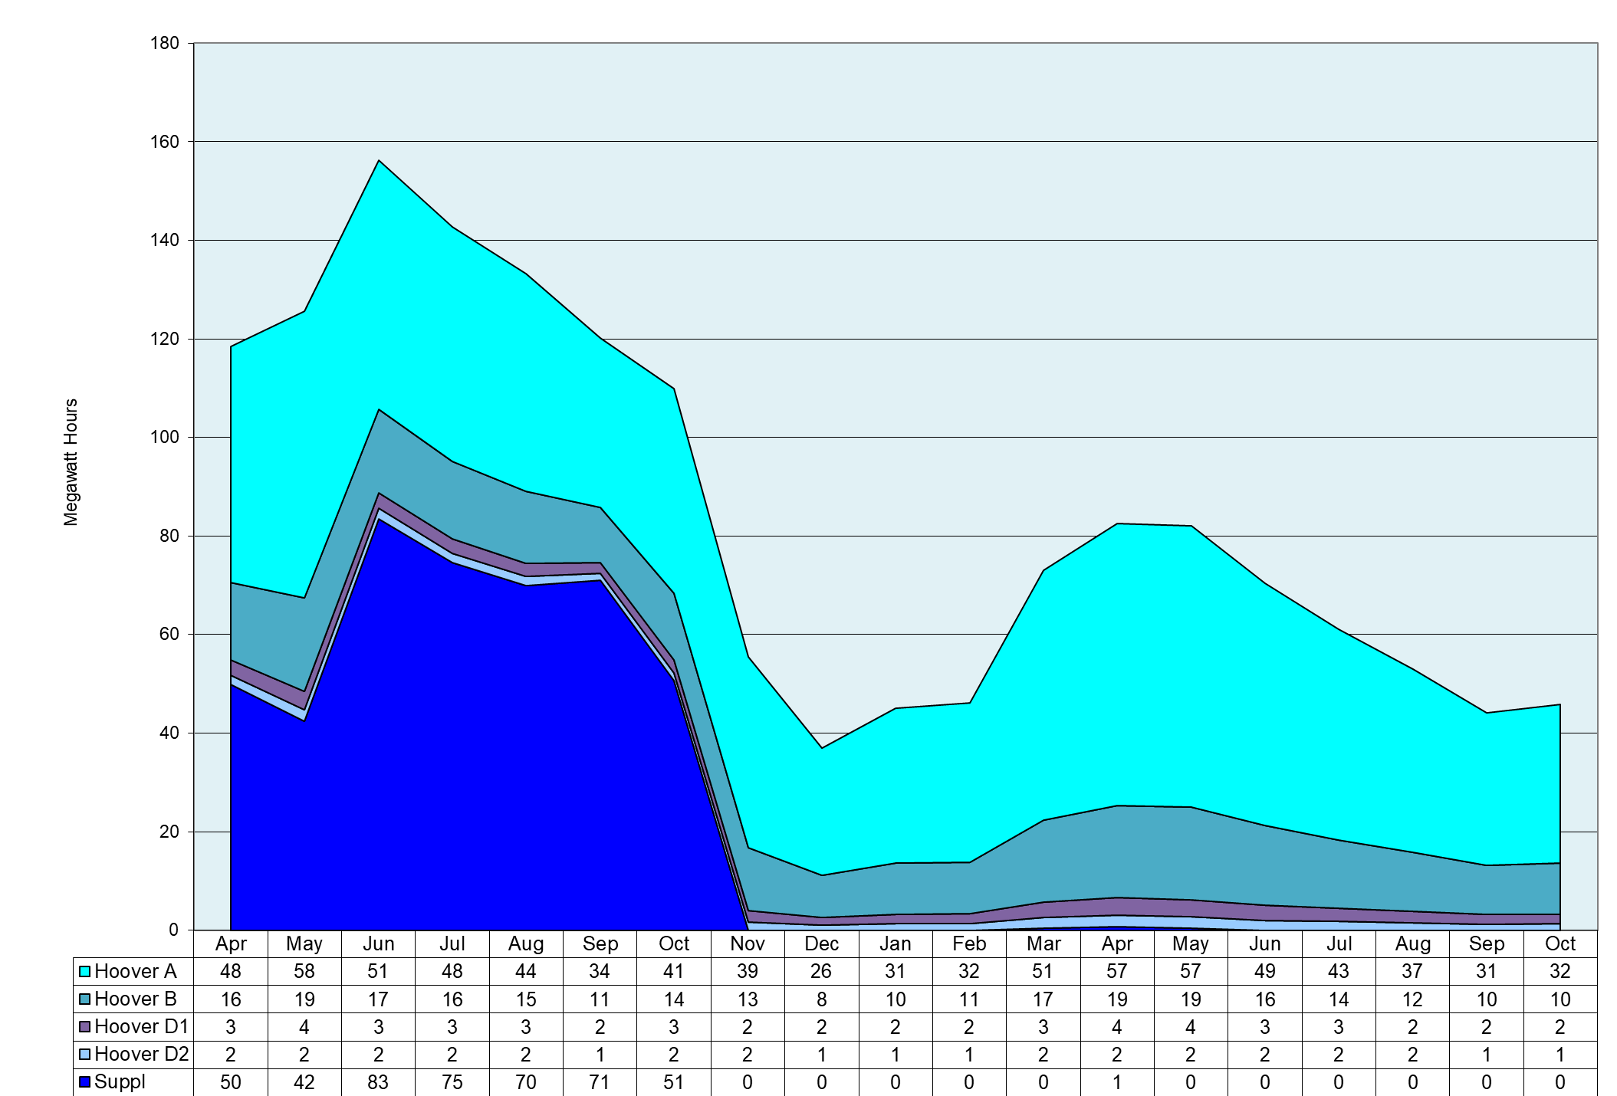
APA Monthly Energy Scheduled April 2020 – October 2021
WY 2020
WY 2021
WY 2022
Notes:
Update using current schedule.

Slide 19
Questions or Comments?
Call Sonseeahray Thayer at:
602-368-4265
For a copy of this report, go to the Power Authority website
at: http://www.powerauthority.org/
and click on downloads.

